Slide 1

Welcome

Slide 2
Teachers Introduction
SK.Abu jafor
Asst. Teacher
B.S.C. High School
Bagerhat
Mob: 01719032520

Slide 3
Subject Introduction
English for today
Class-Ten
Unit-One
Lesson-Four Time-50 minits
Pahela Baishakh

Slide 4
Learning outcomes
S S. will be able to describe about Pahela Baishakh.
SS .will be able how to manage A Baishakhy Mela.
SS will be able to make various poster paper about pahela Baishakh.

Slide 5
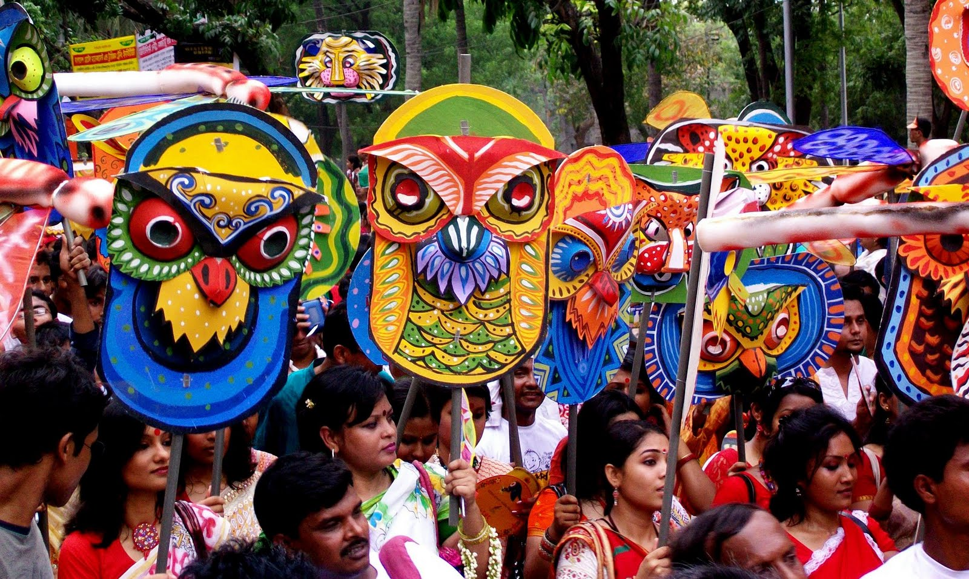
Look at the picture
Can you tell me what you see in the picture?

Slide 6
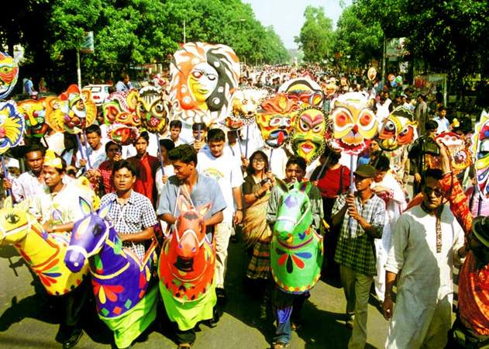
Another picture

Slide 7
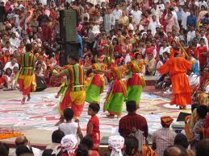
Also picture

Slide 8
After showing pictures– SS will tell?
Pahala Baishakh

Slide 9
Follow the text
Time: 10 minutes .

Slide 10
Now see the video

Slide 11
Word Meaning
1. Celebrate--- --- Observe
2. Festoon --- --- Decorated paper or cloth.
3. Procession--- ---Rally.
4. Mask-- ---Covering.

Slide 12
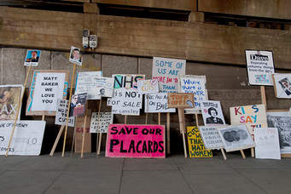
Festoon

Slide 13
Rally

Slide 14
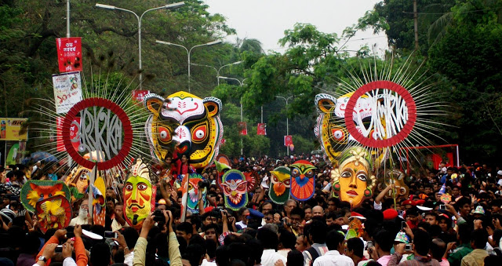
Mask /Covering

Slide 15
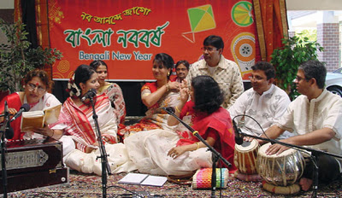
Cultural activity

Slide 16
Pair Work
Discuss it and make a dialogue you and your prtner about Pahela Baishakh.

Slide 17
Important Information
Pahela Baishakh: The first day of Bangla Year.
Halkhata: Shopkeepers will open Halkhata and offer Sweets to their Customers and clients.
Cultural Programme: Various Instutions will arrange Cultural Programme that day.

Slide 18
Group Work
Each (4) four make a group and Write 5 main sentences about Pahela Baishakh.

Slide 19
Evaluation
What kind of Festival is Pahela Baishakh?
2. What is Halkhata?
3.What do national dailies bring out?

Slide 20
Home Work
Write a Paragraph about Baishakhi Mela.

Slide 21
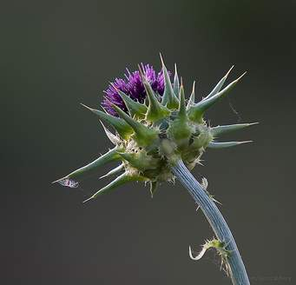
Thank You

